Slide 1
Category review: Chips
February 2025
Retail Analytics
Brand note: If client logo is not required, use alternate title page layout right click slide thumbnail > Layout > Title

Slide 2
Notes:
To view Privacy video explaining how important data privacy is to Quantium, please click here: https://www.youtube.com/watch?v=Zq1QDAkoRzU
or here Q:\Company Reference\Brand & Design\Brand videos\Q Privacy.mp4
At Quantium, we believe that data is the behavioural footprint of humanity and that it has to be treated with the utmost care and responsibility.
Histories, attitudes, indeed lives are stored within it in ways that aren’t always apparent – and that’s what makes its potential so powerful.
To work with it responsibly, sensitively, we set ourselves the highest data privacy protection and governance standards.
We have spent 17 years perfecting privacy-by-design and secure-by-design principles. Central to this is not holding any personally identifiable information about people –
we neither receive it, and put the necessary protections in place to be unable to decipher it.
Every aspect of handling data is safeguarded: from its de-identification, to its encryption – data security is paramount and of the highest grade.
We pride ourselves on gaining the trust of iconic organisations around the world through years of securely working with their data,
and in turn the trust that builds with their stakeholders.

Slide 3
Executive summary
01
Task 1
Analyse the data to understand the current
purchasing trends and behaviours.
Task 2
Compare different control stores to each of the trail stores using Pearson correlations
02

Slide 4

01
We need to present a strategic recommendation to our client that is supported by data which she can then use for the upcoming category review. However, to do so, we need to analyse the data to understand the current purchasing trends and behaviours. The client is particularly interested in customer segments and their chip purchasing behaviour.
Consider what metrics would help describe the customers’ purchasing behaviour.

Slide 5
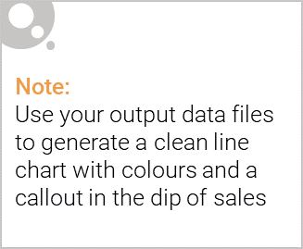
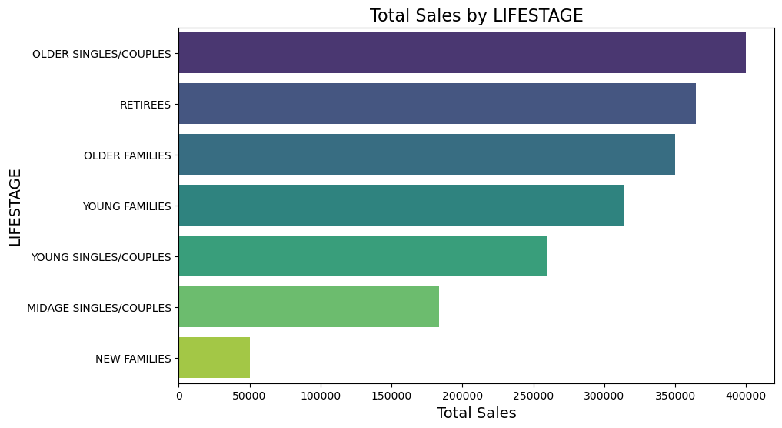
Total Sales by Different Life Stages

Slide 6
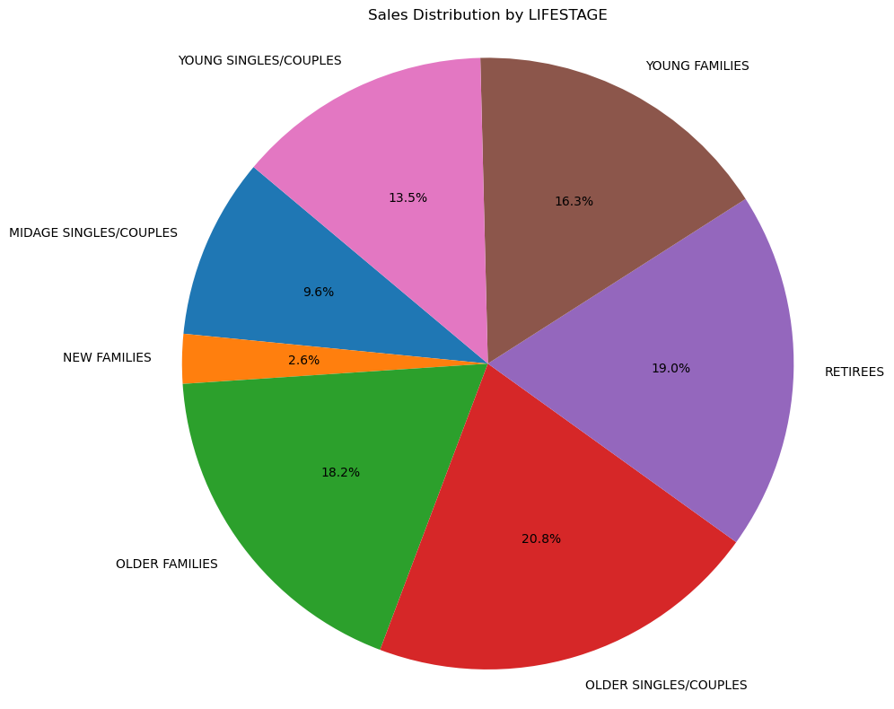
Sales Distribution by LIFESTAGE

Slide 7

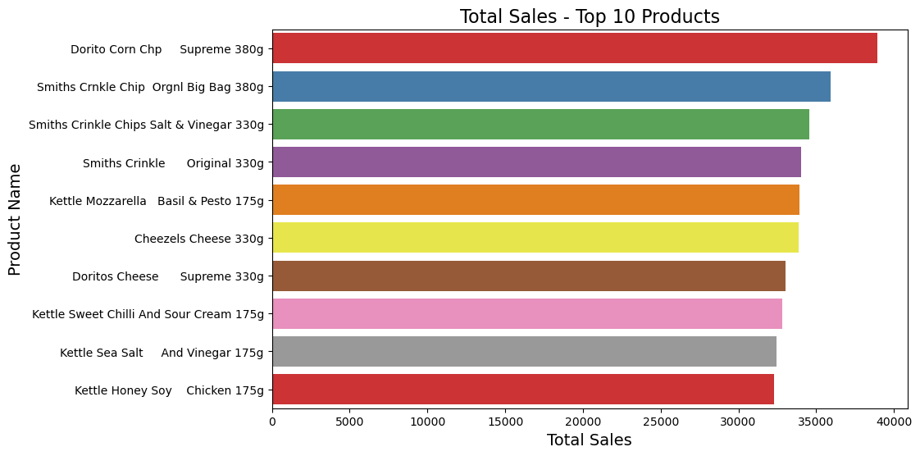
Total Sales - Top 10 Products

Slide 8
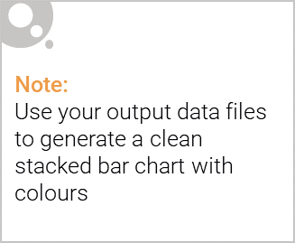
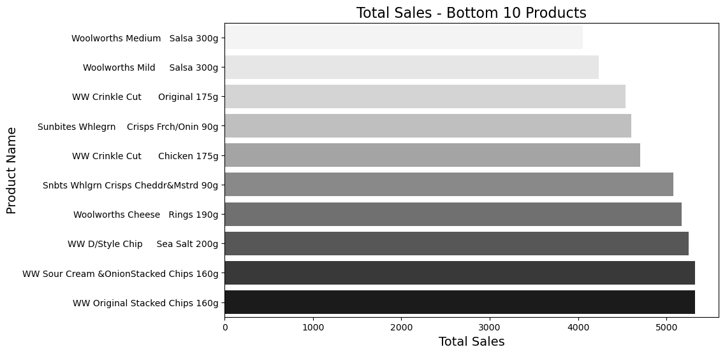
Editable (delete this)
Total Sales - Bottom 10 Products

Slide 9
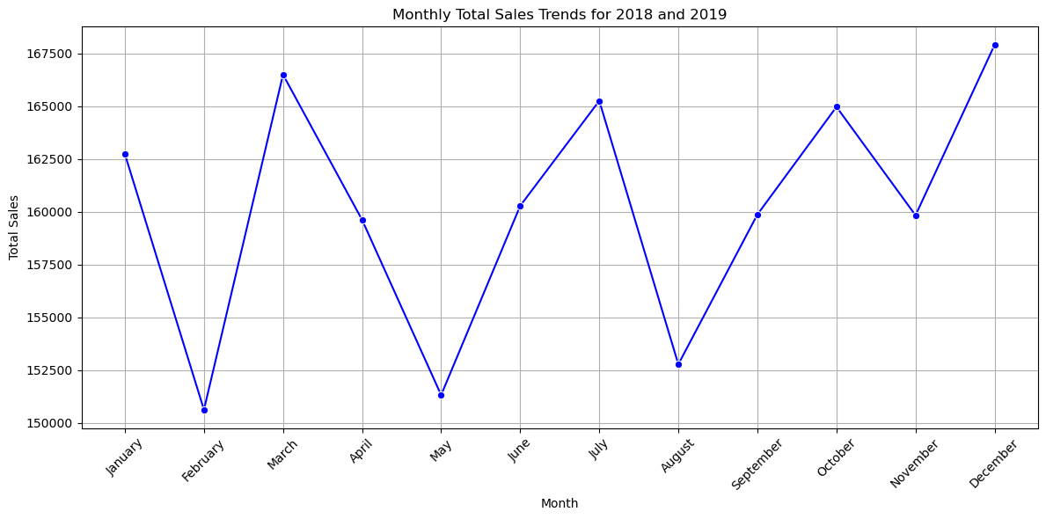
Monthly Total Sales Trends for 2018 and 2019

Slide 10
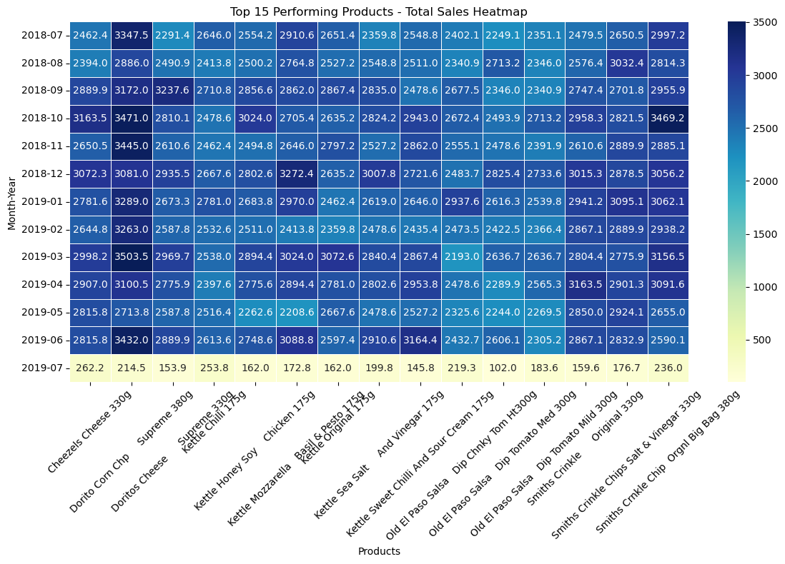
Top 15 Performing Products - Total Sales Heatmap

Slide 11
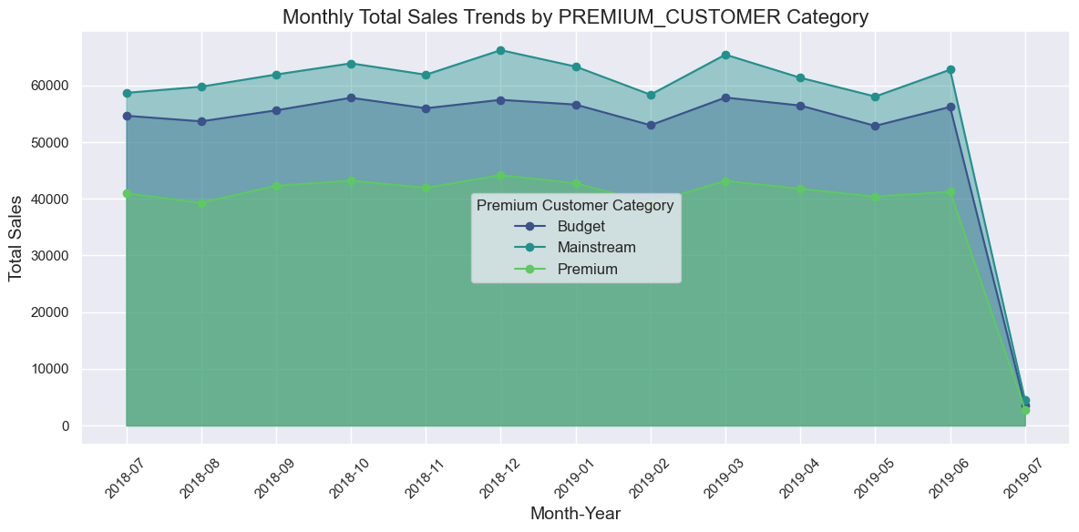
Monthly Total Sales Trends by PREMIUM_CUSTOMER Category

Slide 12
Key Findings for Each Analysis:
Data Cleaning and Preparation:
1. Data Integrity: No null values were present in the datasets. Duplicates were minimal (only one duplicate in the transaction dataset).
2. Outlier Removal: Identified and removed outliers from the TOT_SALES column using the IQR method.
3. Data Merging: Datasets were merged on LYLTY_CARD_NBR, resulting in 264,258 entries.
4. Feature Engineering: Converted dates from numerical format to datetime and categorized life stage and premium customer columns.

Slide 13
Analysis Highlights:
1. Total Sales by Life stage: Older Singles/Couples generated the highest sales (399,971.15 units).
Other significant contributors included Older Families and Retirees.
2. Total Sales by Premium Customer Category: Mainstream customers contributed the most sales (746,475.85 units),
followed by Budget (671,985.80 units) and Premium (503,295.30 units).
3. Product Performance: Top products included Natural Chip Company Sea Salt 175g and CCs Nacho Cheese 175g.
The bottom-performing products were mostly niche or less popular variants.
4. Monthly Sales Trends: Steady sales trends across 2018-2019, with peaks during specific months such as December
(likely due to seasonal demand).
5. Sales Distribution by Life stage: Older demographic groups formed the bulk of sales, aligning with the trend
observed in total sales by life stage.
6. Monthly Sales Comparison by Customer Category: Budget and Mainstream categories showed more consistent
performance compared to Premium customers, which had sporadic peaks.
7. Top Product Sales Heatmap: Certain products showed seasonal trends, peaking during festive periods

Slide 14

Summary/Highlights:
Older demographics are the primary contributors to chip sales, especially in the Mainstream and Budget segments. Product preference varies, with a clear inclination toward popular chip brandlike Natural Chip Co. and CCs. Seasonal trends suggest the importance of strategic promotions during high-demand months like December. The data provides actionable insights for targeted marketing strategies, such as focusing on Older Families and Singles in the Budget and Mainstream categories for maximum ROI.

Slide 15
02
Trial Store vs Control Store
Performance

Slide 16
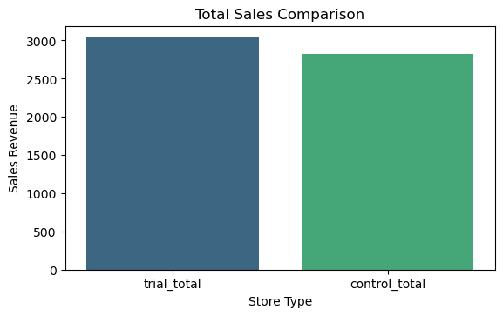
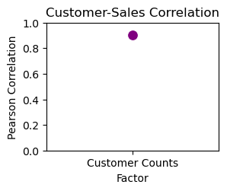
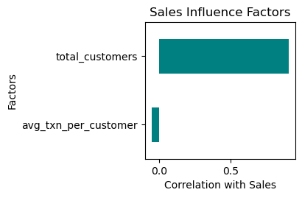
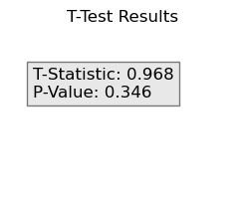
Trail Stores VS Control Stores Performance

Slide 17
Summary of Insights:
Trial Store Performance:
Sales are slightly higher in the trial store compared to the control store, but the difference is not statistically significant.
Key Driver of Sales:
The increase in customer counts is the primary factor influencing sales performance. Efforts to drive sales should focus on attracting more customers rather than increasing transactions per customer.
Statistical Significance:
The lack of statistical significance suggests that the observed differences might not be attributable to the trial intervention. This analysis provides actionable insights for strategizing sales improvement initiatives.

Slide 18

THANK YOU!
Presented by: Shivanand Satyappa Nashi
https://www.linkedin.com/in/shivanand-s-nashi-79579821a
https://github.com/Gtshivanand

